Slide 1
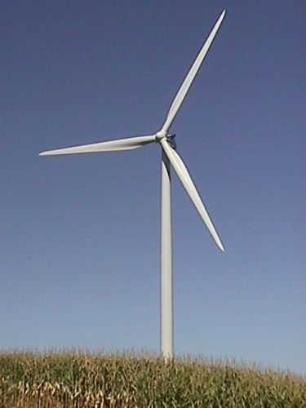
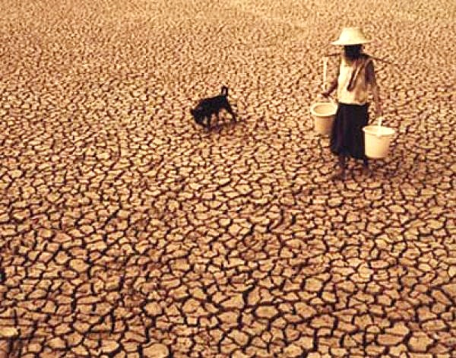
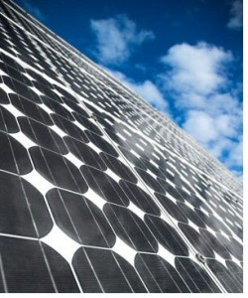
Understanding Climate Finance in the Context of Achieving SDGs
Financing Tools for Reducing
Social Inequalities
Civil Society Policy Forum
April 13, 2016
Muthukumara Mani
Lead Economist
South Asia Region
World Bank

Slide 2
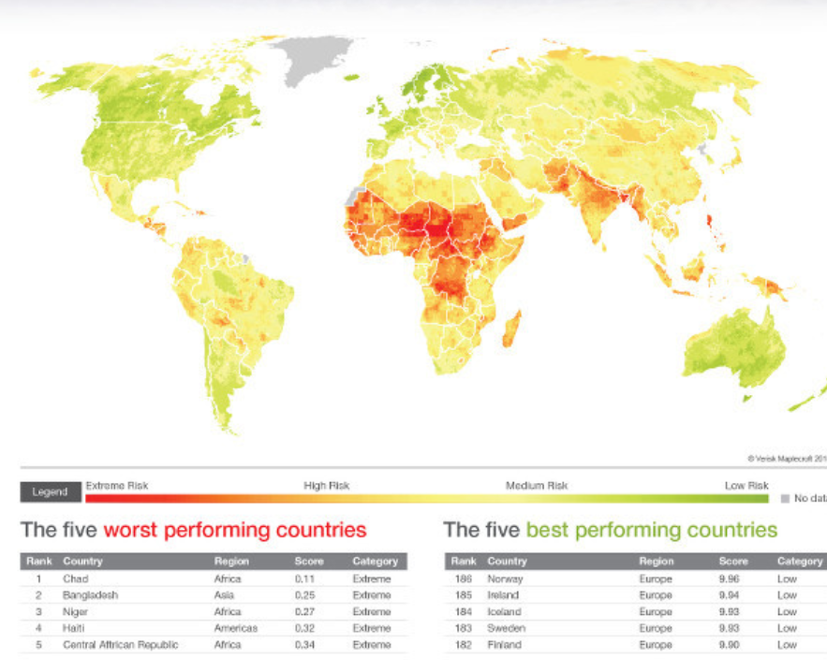
Why climate change is important in the context of development?

Slide 3
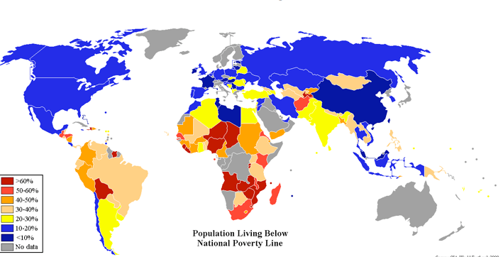
Considerable overlap between climate hotspots and poverty hotspots

Slide 4
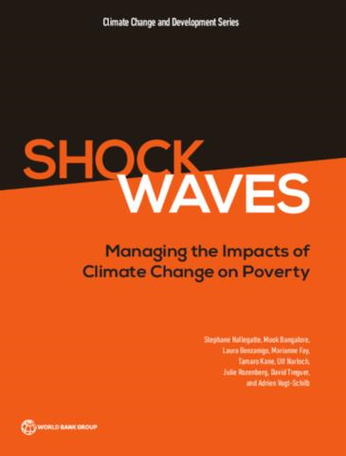
Climate change and poverty
“climate-informed development can prevent most (but not all) consequences of climate change on poverty. Absent such good development, climate change could result in an additional 100 million people living in extreme poverty by 2030”
Shock Waves: Managing the impacts
of Climate Change on Poverty
(World Bank, 2015)

Slide 5
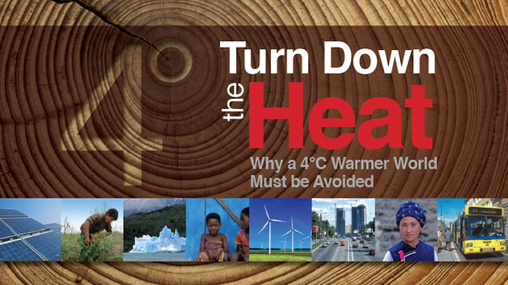
Climate Change—Some Grim Facts
A Four Degree (4°C) world could lead us to:
the inundation of coastal cities;
increasing risks for food production potentially leading to higher under and malnutrition rates;
many dry regions becoming dryer, wet regions wetter;
unprecedented heat waves in many regions,
especially in the tropics;
substantially exacerbated water scarcity in
many regions;
increased intensity of tropical cyclones; and
irreversible loss of biodiversity, including coral
reef systems.
“A 4 degree warmer world can, and must be, avoided – we need to hold warming below 2 degrees”
--World Bank Group President Jim Yong Kim

Slide 6
Projected Impacts of Climate Change
Global temperature change (relative to pre-industrial)
0°C
1°C
2°C
3°C
4°C
5°C
Food
Falling crop yields in many areas, particularly developing regions
Possible rising yields in some high latitude regions
Falling yields in many developed regions
Water
Small mountain glaciers disappear – water supplies threatened in several areas
Significant decreases in water availability in many areas, including Mediterranean and Southern Africa
Sea level rise threatens major cities
Ecosystems
Extensive Damage to Coral Reefs
Rising number of species face extinction
Extreme Weather Events
Rising intensity of storms, forest fires, droughts, flooding and heat waves
Risk of Abrupt and Major Irreversible Changes
Increasing risk of dangerous feedbacks and abrupt, large-scale shifts in the climate system
Notes:
The projected impacts of climate change over multi-dimensions aggregated across several studies.
The arrows indicate the approximate temperature at which we might start to see these impacts – were the darkening shade shows the increasing risk and intensity of impacts as temperatures rise.
Already committed to 0.5 – 1degC of temperature change above pre-industrial. BAU gives serious risks of exceeding 5degC.
Source: Stern Review synthesis
Specific Examples:
Food: (1) from 1degC expect severe impacts in marginal Sahel, (2) 2 – 3degC may see 25 – 60% more people at risk from hunger, with half the increase in Africa and W. Asia (assuming weak carbon fertilisation). (3) 4 – 5degC, crop yields decline by up to a third in Africa. Sharp declines in crop yields in tropical regions.
Water: (1) 2 – 3degC, more than 30% degree in water flows in Mediterranean and Southern Africa. (2) 3degC, more than one billion people suffer water shortages, many in Africa (year:2080s).
Ecosystems: (1) 3degC, 20 – 50% of species face extinction (2) 1 – 2degC, irreversible damage or even loss of large fraction of coral reefs. Continued increase in ocean acidity seriously disrupting marine ecosystems and possible fish stocks.
Land (1) Permafrost thawing damages buildings and roads in parts of Canada and Russia (2) 2degC Up to 10 million more people affected by coastal flooding each year (3) 1-170 million more people exposed to coastal flooding each year (4) 4degC Up to 7-300 million more people exposed to coastal flooding each year
Extreme Weather Events: (1) 3degC, small increases in hurricane intensity lead to doubling of damage costs in the US. (2) 3degC serious droughts in Europe occur once every 10 years.
Abrupt and Major CC: (1) 2 – 3degC onset of irreversible melting of the Greenland ice sheet. (2) 3 – 5degC dangerous territory – risk of collapse of ocean currents and West Antarctic ice sheet.
Change physical and human geography: Severe deterioration in the local climate could lead to ass migration and conflict in some parts of the developing world especially as another 2-3 billion people are added to the developing world’s population in the next few decades

Slide 7
Sustainable Development Goals
Building on MDGs but significant emphasis on sustainability (11 of 17)
Increased ambition on poverty reduction (ending poverty everywhere, lifelong learning, health for all ages etc.)
Take urgent action to combat climate change and its impacts (goal 13)

Slide 8
Paris Agreement – key elements (1)
Ambition: temperature change “well below 2ºC” and to “pursue efforts” to limit to 1.5ºC
    Commitments to be progressively increased to achieve temperature goal
    Emissions of each country to peak “as soon as possible”
    Net zero emission in the “second half of this century”
Differentiation between countries blurring:
    All counties take commitments
    Evolving from CBDR to self-differentiation through Nationally Determined Contributions (NDCs) to climate action
    non-binding character of NDCs, and the reliance on transparency rather than legal enforcement to promote accountability and effectiveness
    Initial NDCs are “floors” not the “ceiling”

Slide 9
Paris Agreement – key elements (2)
Durable agreement:
    Agreement does not have an end date like the Kyoto Protocol
    Unlike the UNFCCC, has a framework for countries based on evolving “national circumstances”
    Progressively tightening ambition for climate action (mitigation, adaptation and climate finance) every 5 years based on a global stock-take
Rule-based structure:
    a hybrid architecture, supplementing the bottom-up system of NDCs with internationally-negotiated rules
    introduces some discipline into the national pledging and assessment of progress in implementation process
    Reporting obligation on progress with NDCs for all countries

Slide 10
Paris Agreement – key elements (3)
Climate finance. Goal of $100 billion/ year by 2020 by Developed countries
    To be reviewed to set a higher goal in 2025, i.e. a “floor and a pathway” to increase financial support
    Public and private sources, “noting the significance of public resources”
    Encourages other countries to contribute
  Carbon market mechanisms through voluntary cooperation
    Internationally transferred mitigation outcome can be used towards NDCs
    Mechanism to contribute to mitigation of greenhouse gases also establishes

Slide 11
How to reconcile climate finance with SGD finance?
Development is the best adaptation
investing in skills, health, knowledge, better infrastructure and a more diversified economy will render countries more climate-resilient (good development is good adaptation).
Resilient development is smart development
build climate and disaster resilience into national policies, programs and projects.

Slide 12
How to reconcile climate finance with SGD finance?
Climate finance should be designed to complement and take advantage of the climate aspects of development decisions
--climate resilience infrastructure
--climate smart agricultural practices
--incentivizing private adaptation actions (water, agriculture, health etc.)
“additional” /“complement”

Slide 13
How to reconcile climate finance with SGD finance?
Mitigation
Climate finance can help leverage development finance to promote low-carbon development (by improving the financial risk-return performance of low carbon versus high-carbon investments)
Help avoid “lock-in” effects
Need to recognize co-benefits (health, ecosystems etc.)

Slide 14
Climate finance in Mitigation
Policy Gaps:
  Missing or deficient regulatory frameworks (carbon tax, RE policy etc.)
Knowledge gaps:
  Lack of information, capacity & know-how designing and executing projects
Funding, viability & risk coverage gaps:
  Financial constraints & risk aversion

Slide 15
Conclusion
Significant challenge ahead for implementing SDGs and Paris Commitments
Limited international public resources
Need to exploit synergies (between sustainable development and climate-smart development)
Leverage climate finance to achieve broader development objectives (low carbon, climate resilient development)
Provide coherent policy framework for private investments and private actors

Slide 16
Thank you
Muthukumara Mani: mmani@worldbank.org

